Slide 1
Mobile Application
Prepared By Mabelle Tannoury

Slide 2
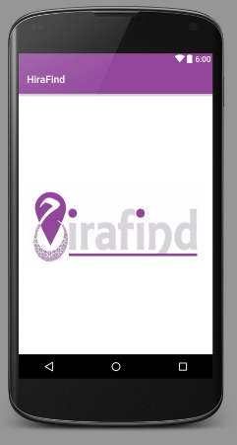

Application icon
Splash Screen

Slide 3
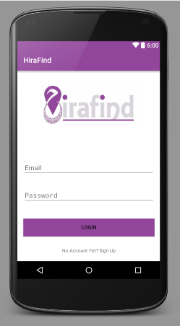
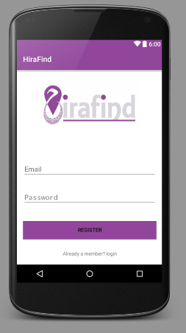
Login page
Register page

Slide 4
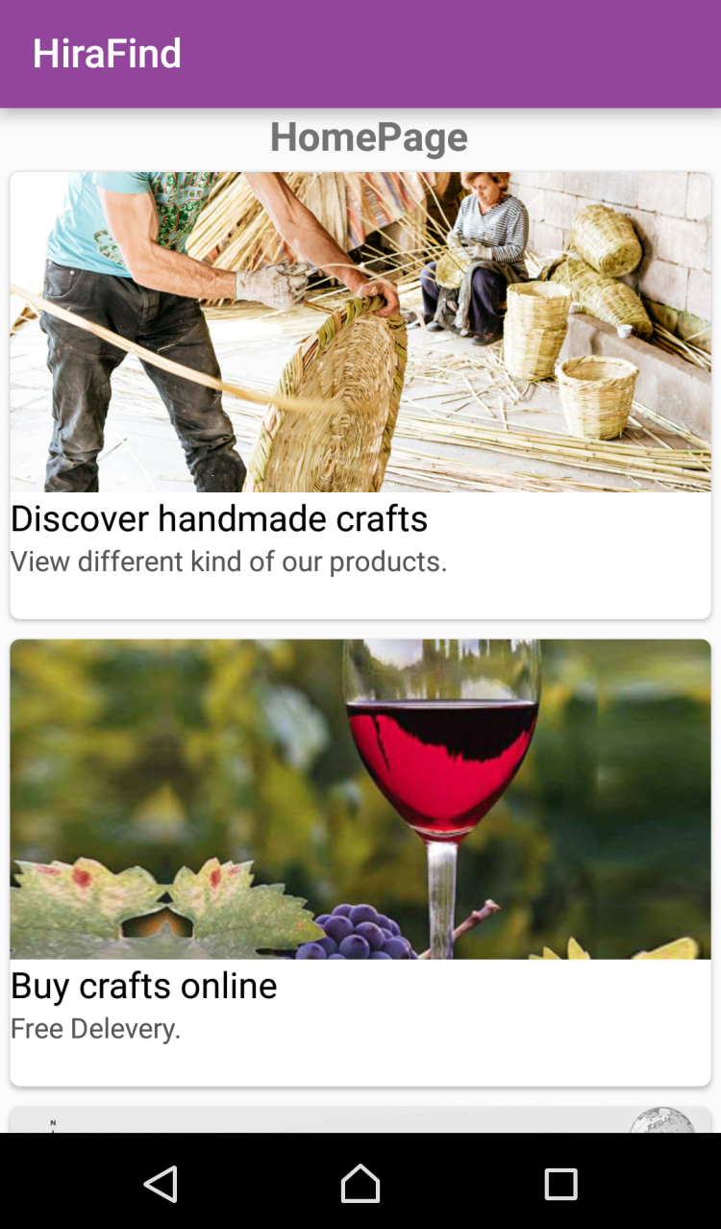
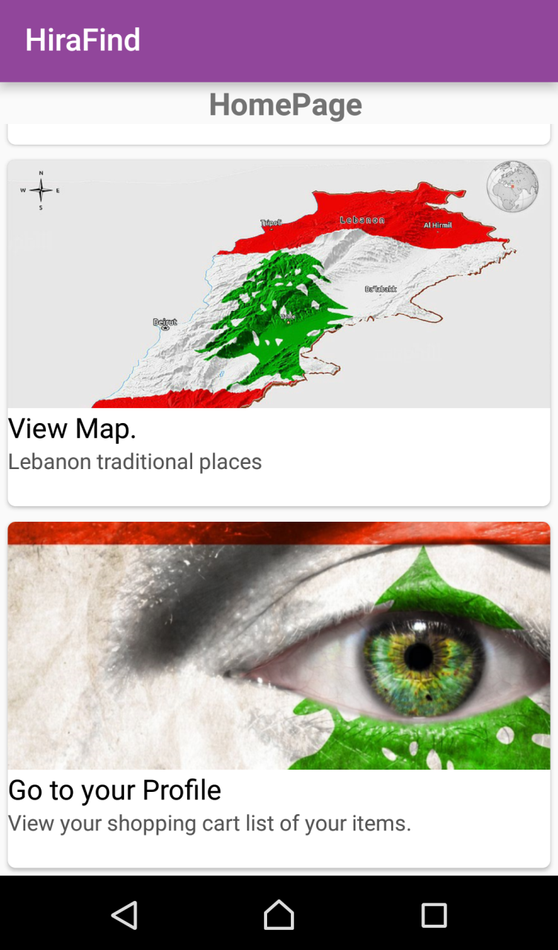
Home Page

Slide 5
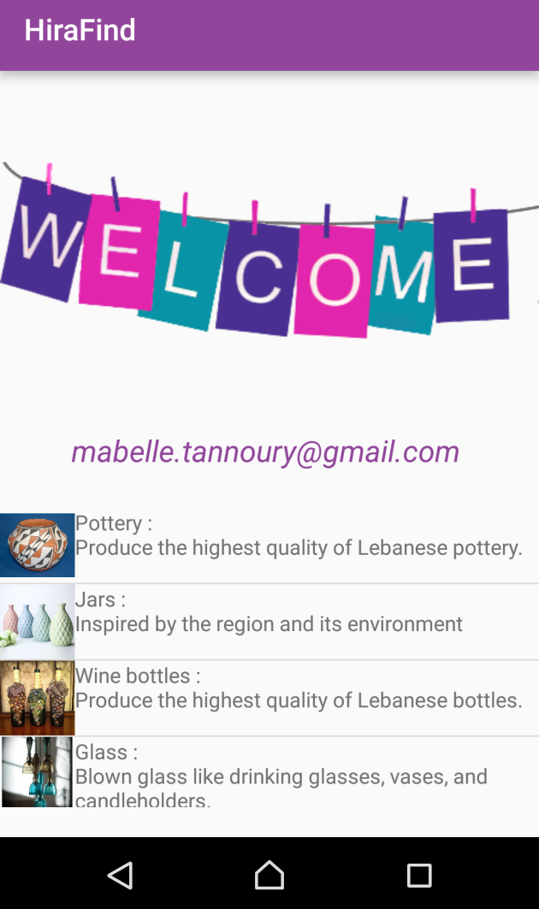
Discover handmade crafts page

Slide 6
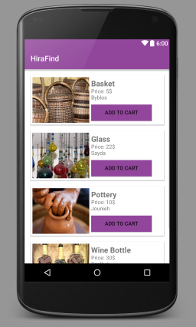
ADD TO CART

Slide 7
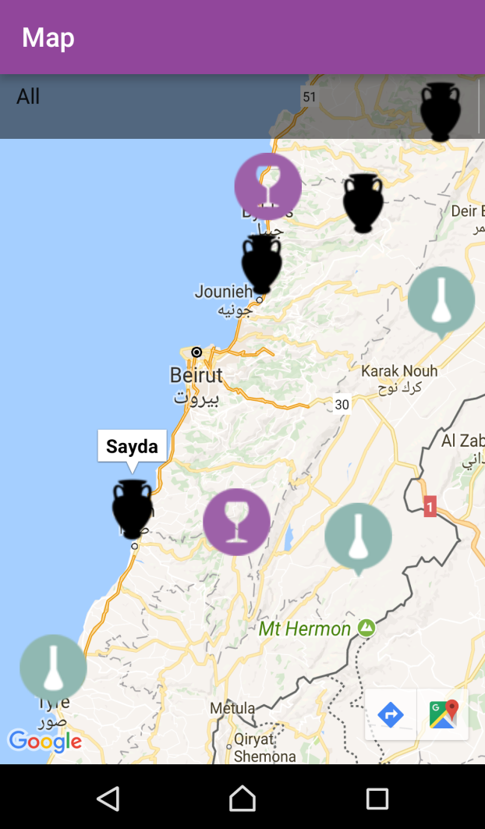
MAPS

Slide 8
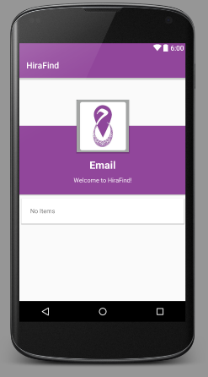
Profile

Slide 9
THANK YOU!

